Slide 1
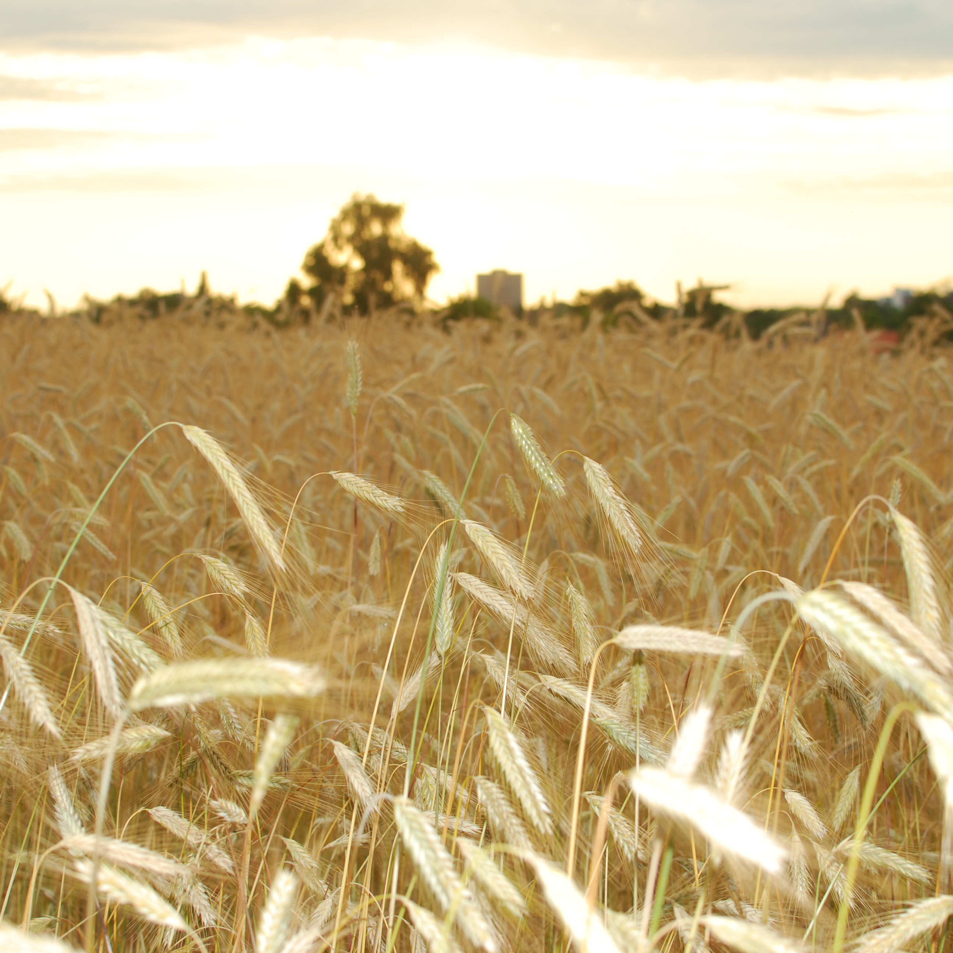


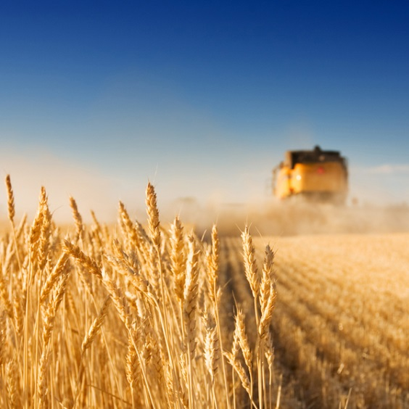
The WOFOST Cropping System Model
Introducing main concepts and processes
June 2022, Allard de Wit (modified by Joao Vasco Silva, July 2023)

Slide 2
WOFOST: the basics
WOrld FOod STudies: simulation model for the quantitative analysis of growth and production of annual field crops
Simulates for different agro-ecological production levels
Characteristics:
Mechanistic
dynamic (daily timesteps)
multi-crop (parameters define the crop type)
Developed in Wageningen since the 1990-ies
Public model, open source implementations available

Slide 3
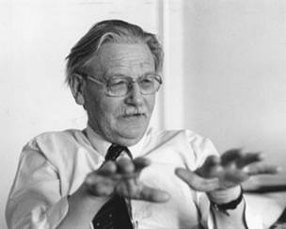
Pedigree of models of “School of De Wit”
1965
Photosynthesis of leaf canopies
(de Wit 1965)
1970
ELCROS
(de Wit et al. 1970)
MICROWEATHER
(Goudriaan 1977)
1975
ARID CROP
(van Keulen 1975)
ARID CROP
(SAHEL)
(van Keulen et al. 1986)
BACROS
(de Wit et al. 1978)
PHOTON
(de Wit et al. 1978)
1980
PAPRAN
(Seligman & van Keulen 1981)
SUCROS
(van Keulen et al. 1982)
SUCROS87
(van Laar et al. 1992)
SUCROS1
(Goudriaan & van Laar 1994)
SUCROS2
(van Laar et al. 1997)
1985
MACROS
(Penning de Vries et al. 1989)
SWHEAT
(van Keulen & Seligman 1987)
WOFOST 7
(van Diepen et al. 1988)
(van Keulen & Wolf 1986)
WOFOST 7.2
(De Wit et al 2019)
WOFOST 8
(Berghuis et al. In prep.)
1990
INTERCOM
(Kropff & van Laar 1993)
1995
LINTUL
(Adiele et al 2022)
ORYZA
(Kropff et al. 1995)
ORYZA2000
(Bouman et al. 2001)
ORYZA v3
(Bouman et al. 2013
2000
GECROS
(Yin and Struik 2017)
2022

Slide 4
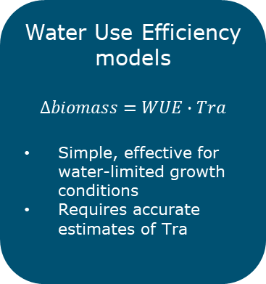
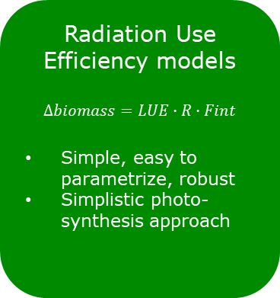
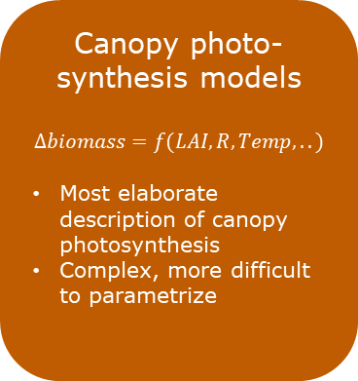
Categories of mechanistic crop models
Radiation Use Efficiency models
$$∆biomass=LUE∙R∙Fint$$
Simple, easy to parametrize, robust
Simplistic photo-synthesis approach
Water Use Efficiency models
$$∆biomass=WUE∙Tra$$
Simple, effective for water-limited growth conditions
Requires accurate estimates of Tra
Canopy photo-synthesis models
$$∆biomass=f(LAI, R, Temp,..)$$
Most elaborate description of canopy photosynthesis
Complex, more difficult to parametrize
WOFOST model

Slide 5
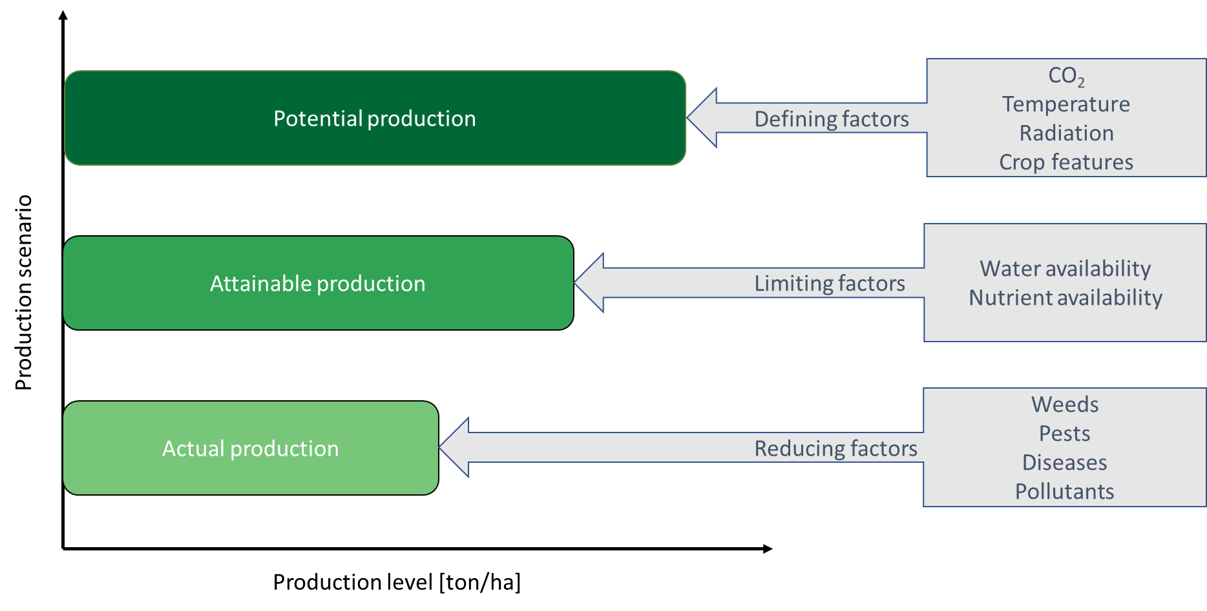
WOFOST – Agro-ecological production levels
WOFOST 7.2
WOFOST 8
Notes:
Nutrients:
WOFOST (fortran version) can calculate nutrient-limited production under non-fertilized soils and the amount of plant nutrients needed to attain potential and water-limited production levels (balance approach applied after dynamic simulation)
Post processing based on basic soil supply and the required nutrients for the potential levels assuming a certain constant apparent fertilizer recovery
Calculations of the nutrient requirements for potential and water limited production are based on the ‘Basic soil supply’ of the nutrients and the ‘Apparent recovery fraction’ of extra fertilizer applied to the crop needed to reach the potential and water limited production level.
In PCSE: dynamic simulation of N, P and K but basic soil supply must be given, not yet published (is being tested)

Slide 6
Agro-ecological production levels
Potential yield – yield potential:
the yield of crop when grown under defined conditions (CO₂, Temperature, radiation) without growth limitations from water, nutrients, pests or diseases
Water-limited/nutrient-limited yield:
the yield of a crop when grown with water limitation or with one or more nutrient deficiencies as the primary growth limiting factors
Actual yield:
the measured yield from a field or farm, or the estimated average yield for a region or nation as reported in national and international databases.

Slide 7
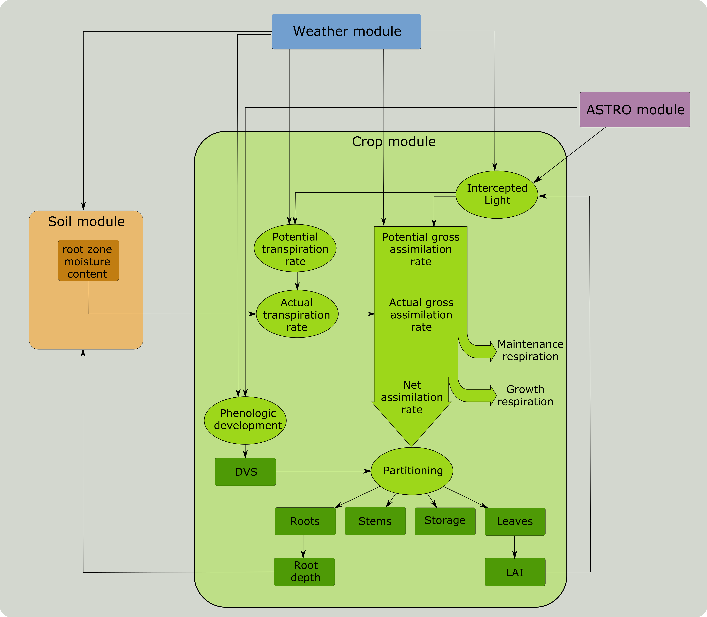
WOFOST process flow diagram

Slide 8
WOFOST modelled processes
Phenology
Leaf development
Light interception
CO₂ assimilation
Maintenance respiration
Biomass partitioning
Growth respiration
Transpiration rate
Nutrient uptake rate (v8 only)
Biomass and nutrient reallocation (V8 only)
Stress factors related to water and nutrient deficiencies

Slide 9
WOFOST modelled processes
Phenology
Leaf development
Light interception
CO₂ assimilation
Maintenance respiration
Biomass partitioning
Growth respiration
Transpiration rate
Nutrient uptake rate (v8 only)
Biomass and nutrient reallocation (V8 only)
Stress factors related to water and nutrient deficiencies

Slide 10
Understanding phenology is important
Temperature, radiation and CO₂ drive crop growth
Phenological development steers crop growth
Thus:
Phenological development is a parallel controlling process
Correctly simulating phenological development is the first priority of crop models and model calibration always start with phenology!

Slide 11
Phenology
Phenological development and model DVS:
Sowing DVS=-0.1
Emergence DVS=0
tiller formation
floral initiation or double ridge appearance
spikelet formation
stem elongation
anthesis (flowering) DVS=1
grain set/filling
grain ripening
Physiological maturity DVS=2
For root/tuber crops DVS=1 means the start of root/tuber formation. E.g. flowering in potato is not relevant in WOFOST.

Slide 12
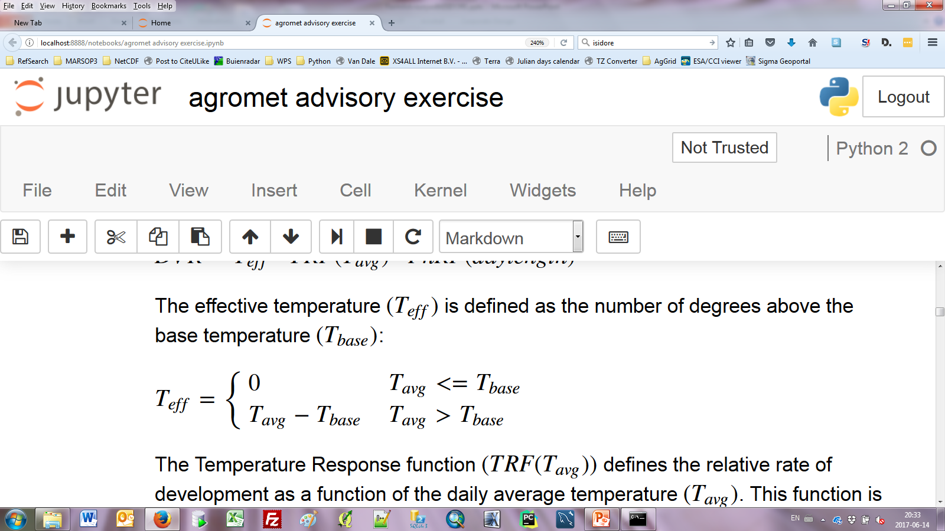
Phenology
Main driving variable is accumulated temperature (e.g. Growing Degree Days):
Accumulation is modified by reduction for day length and vernalisation
∆TSUM $=Teff∙f(daylength)∙f\text{(}\text{vern}\text{alization}\text{)}$
Increase in development is the increase in TSUM divided by the TSUM required to reach that stage
∆DVS $=$ ∆TSUM / TSUM_{stage}
Note: For many crops/cultivars impact of day length and vernalization is not applicable or well-known.

Slide 13
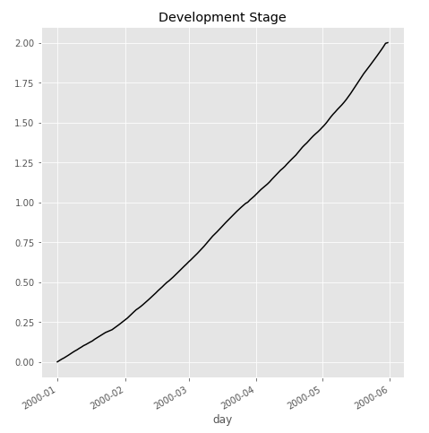
Phenology: understanding DVS
Maturity
Defined by TSUM2 (TSUMAM in SWAP-WOFOST)
Anthesis
Defined by TSUM1 (TSUMEA in SWAP-WOFOST)
Vegetative
reproductive

Slide 14
WOFOST modelled processes
Phenology
Leaf development
Light interception
CO₂ assimilation
Maintenance respiration
Biomass partitioning
Growth respiration
Transpiration rate
Nutrient uptake rate (v8 only)
Biomass and nutrient reallocation (V8 only)
Stress factors related to water and nutrient deficiencies

Slide 15
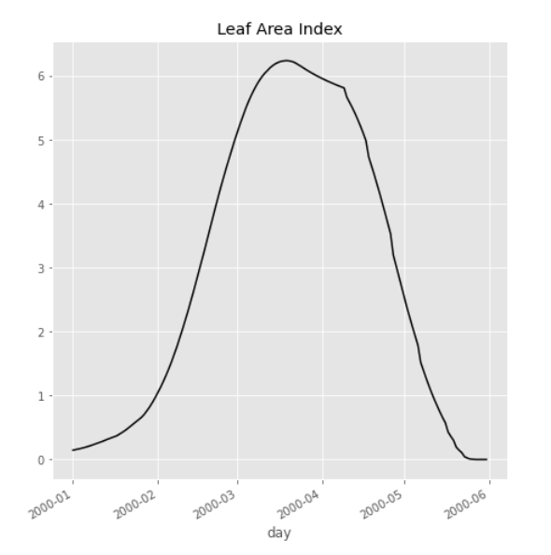
Leaf dynamics: relevant parameters
Green leaf area index for wheat in Spain
Death of leaf area defined by:
Leaf exceeding leaf age
Self-shading
Water/nutrient stress
Growth of leaf area defined by:
Initial leaf biomass
Assimilates sent to leaves
Leaf thickness (m² of leave per kg of biomass)

Slide 16
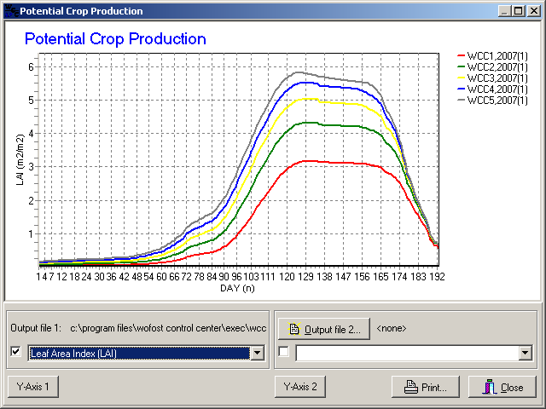
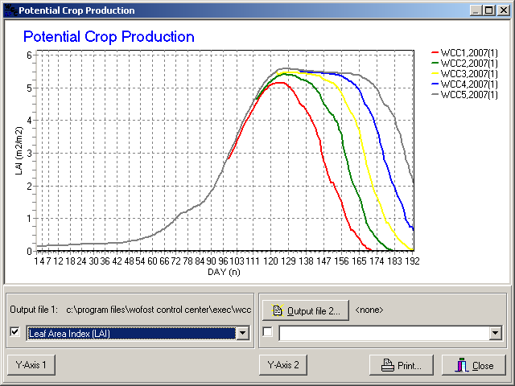
Leaf dynamics: impact of parameter values
Impact of initial biomass (TWDI)
Impact of leaf age (SPAN)

Slide 17
WOFOST modelled processes
Phenology
Leaf development
Light interception
CO₂ assimilation
Maintenance respiration
Biomass partitioning
Growth respiration
Transpiration rate
Nutrient uptake rate (v8 only)
Biomass and nutrient reallocation (V8 only)
Stress factors related to water and nutrient deficiencies

Slide 18
CO₂ assimilation / photosynthesis
Energy provided by capturing solar radiation
Photosynthesis means:
$$CO2+H2O+energy=CH2O+O2$$
Respiration means:
$CH2O+O2$ $=CO2+H2O+energy$
Biochemical energy becomes available for plant processes

Slide 19
CO₂ assimilation in WOFOST
Most complex part of the model
WOFOST performs 3x3 Gaussian integration:
3 levels of canopy depth
3 integration over the day
12 parameters involved: e.g. PLR curve, extinction & scattering coefficient, reflection & absorption, etc.

Slide 20
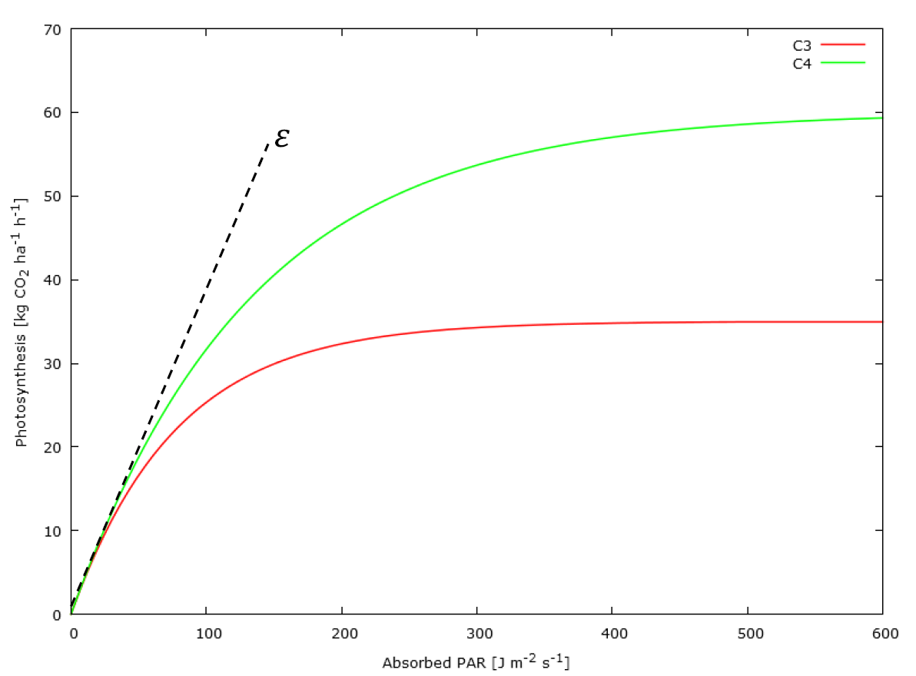
CO₂ assimilation at the leaf level
Photosynthesis – light response (PLR) curve
Quickly saturates at high radiation levels
Higher for C4 crops compared to C3 crops
PLR curve is used to estimate instantaneous photosynthesis rate at the leaf level
Requires scaling over canopy and day

Slide 21


CO₂ assimilation at the canopy level
Direct radiation
+
Diffuse radiation
reflection
Absorption + scattering
1st integration
2nd integration
3rd integration

Slide 22
CO₂ assimilation at the daily level
Daily diffuse radiation
+
2nd integration
1st integration
3rd integration
1st integration
2nd integration
3rd integration

Slide 23
Photosynthesis temperature response

Slide 24
WOFOST modelled processes
Phenology
Leaf development
Light interception
CO₂ assimilation
Maintenance respiration
Biomass partitioning
Growth respiration
Transpiration rate
Nutrient uptake rate (v8 only)
Biomass and nutrient reallocation (V8 only)
Stress factors related to water and nutrient deficiencies

Slide 25
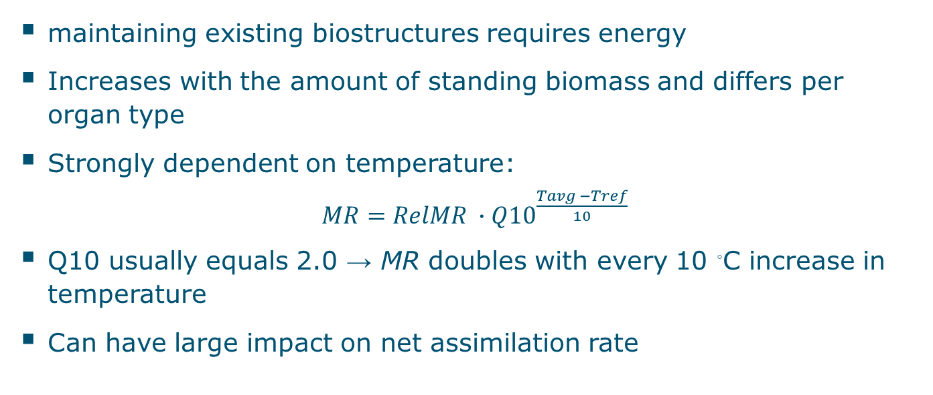
Maintenance respiration
maintaining existing biostructures requires energy
Increases with the amount of standing biomass and differs per organ type
Strongly dependent on temperature:
$MR=RelMR ∙{Q10}^{\frac{Tavg −Tref}{10}}$
Q10 usually equals 2.0 → MR doubles with every 10 ◦C increase in temperature
Can have large impact on net assimilation rate

Slide 26
WOFOST modelled processes
Phenology
Leaf development
Light interception
CO₂ assimilation
Maintenance respiration
Biomass partitioning
Growth respiration
Transpiration rate
Nutrient uptake rate (v8 only)
Biomass and nutrient reallocation (V8 only)
Stress factors related to water and nutrient deficiencies

Slide 27
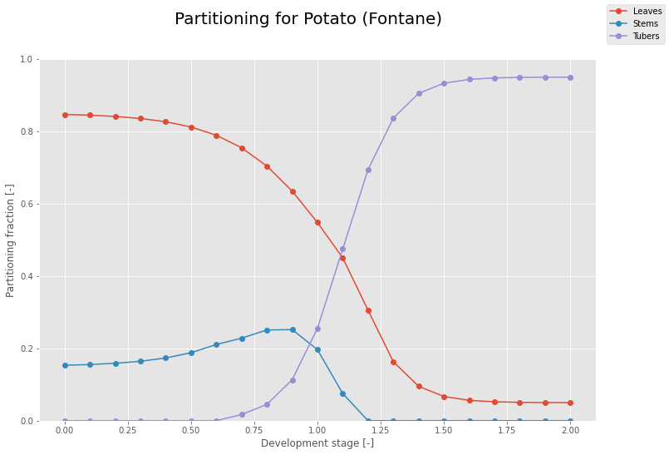
Assimilate partitioning
WOFOST uses static partitioning tables
Pro:
Simple, robust concept
Con:
Depends on correct phenology
Source driven, not sink limited
No impact of growth conditions

Slide 28
WOFOST modelled processes
Phenology
Leaf development
Light interception
CO₂ assimilation
Maintenance respiration
Biomass partitioning
Growth respiration
Transpiration rate
Nutrient uptake rate (v8 only)
Biomass and nutrient reallocation (V8 only)
Stress factors related to water and nutrient deficiencies

Slide 29
Growth respiration
Growth respiration is the amount of energy required to synthesize biomass from carbohydrates
Defined as a conversion efficiency carbohydrate -> roots, stems, leaves, storage organs
Crop | Conversion efficiency to storage organs
Potato | 0.85
Wheat | 0.71
Fababean | 0.59
Soybean | 0.48
Rapeseed | 0.45
Conversion efficiency decreases with increasing content of protein/lipids: requires more energy to synthesize

Slide 30
WOFOST modelled processes
Phenology
Leaf development
Light interception
CO₂ assimilation
Maintenance respiration
Biomass partitioning
Growth respiration
Transpiration rate
Nutrient uptake rate (v8 only)
Biomass and nutrient reallocation (V8 only)
Stress factors related to water and nutrient deficiencies

Slide 31
Water stress response
θ_{cr}
θ_{cr} is variable and depends on ET₀ and the crop group number DEPNR: 5 = drought resistant 1 = drought sensitive
Assimilation rate is reduced according the ratio of actual to potential transpiration (T_{a}/T_{p})
Exact calculation of water stress response depends also on water balance implementation
 | No stress
 | Drought stress
 | Oxygen stress
θ
wp
θ
cr
θ
fc
θ
st

Slide 32
Limitations of WOFOST 7.2
Inherent to simulation technique:
Multi-parameter model, difficult to calibrate and validate
Sensitive for initial state of soil and crop
Chosen generalizations:
Growth is source driven, not sink limited
No crop architecture (plant height, branching, individual leaves, number of grains)
Homogeneous canopy, no effect of rows, N-S orientation)
No translocation of assimilates between organs. (Will be included in v8)
Limited knowledge of crop response relations:
Empirical relations, e.g. partitioning, mechanism not well understood
Best for near optimum growth conditions
Severe stress difficult to quantify
Recovery mechanisms unknown

Slide 33
WOFOST implementations

Slide 34

WOFOST applications: MARS
Backbone of MARS Crop Yield Forecasting System (MCYFS)
Provides timely, independent and scientifically relevant:
Information on crop development and growth
Information on short-term effects of meteo events on crops
Seasonal yield forecasts of key crops (cereal, oil seed crops, protein crops, sugar beet, potatoes, pastures, rice) at EU and member state level
Developed by WUR in 90s, acknowledged by EU parliament, operationally run by WUR since 2000
https://ec.europa.eu/jrc/en/research-topic/crop-yield-forecasting

Slide 35
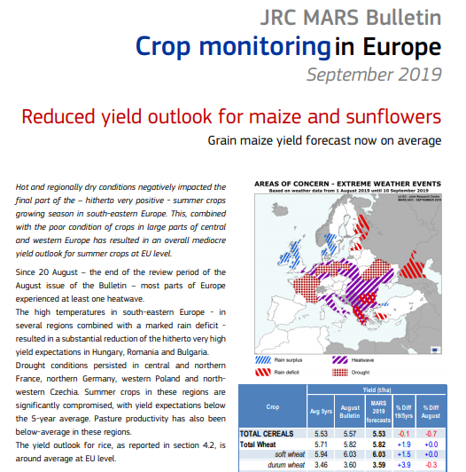
WOFOST applications: MARS
Notes:
MARS
WOFOST is run for all major arable crop in Europe at fine grid with local weather, soil and crop data
Including an archive and up to today
Used to follow the growing conditions and production in the on-going season to detect anomaly hotspots
Input for statistical framework of crop yield forecasting at national level

Slide 36
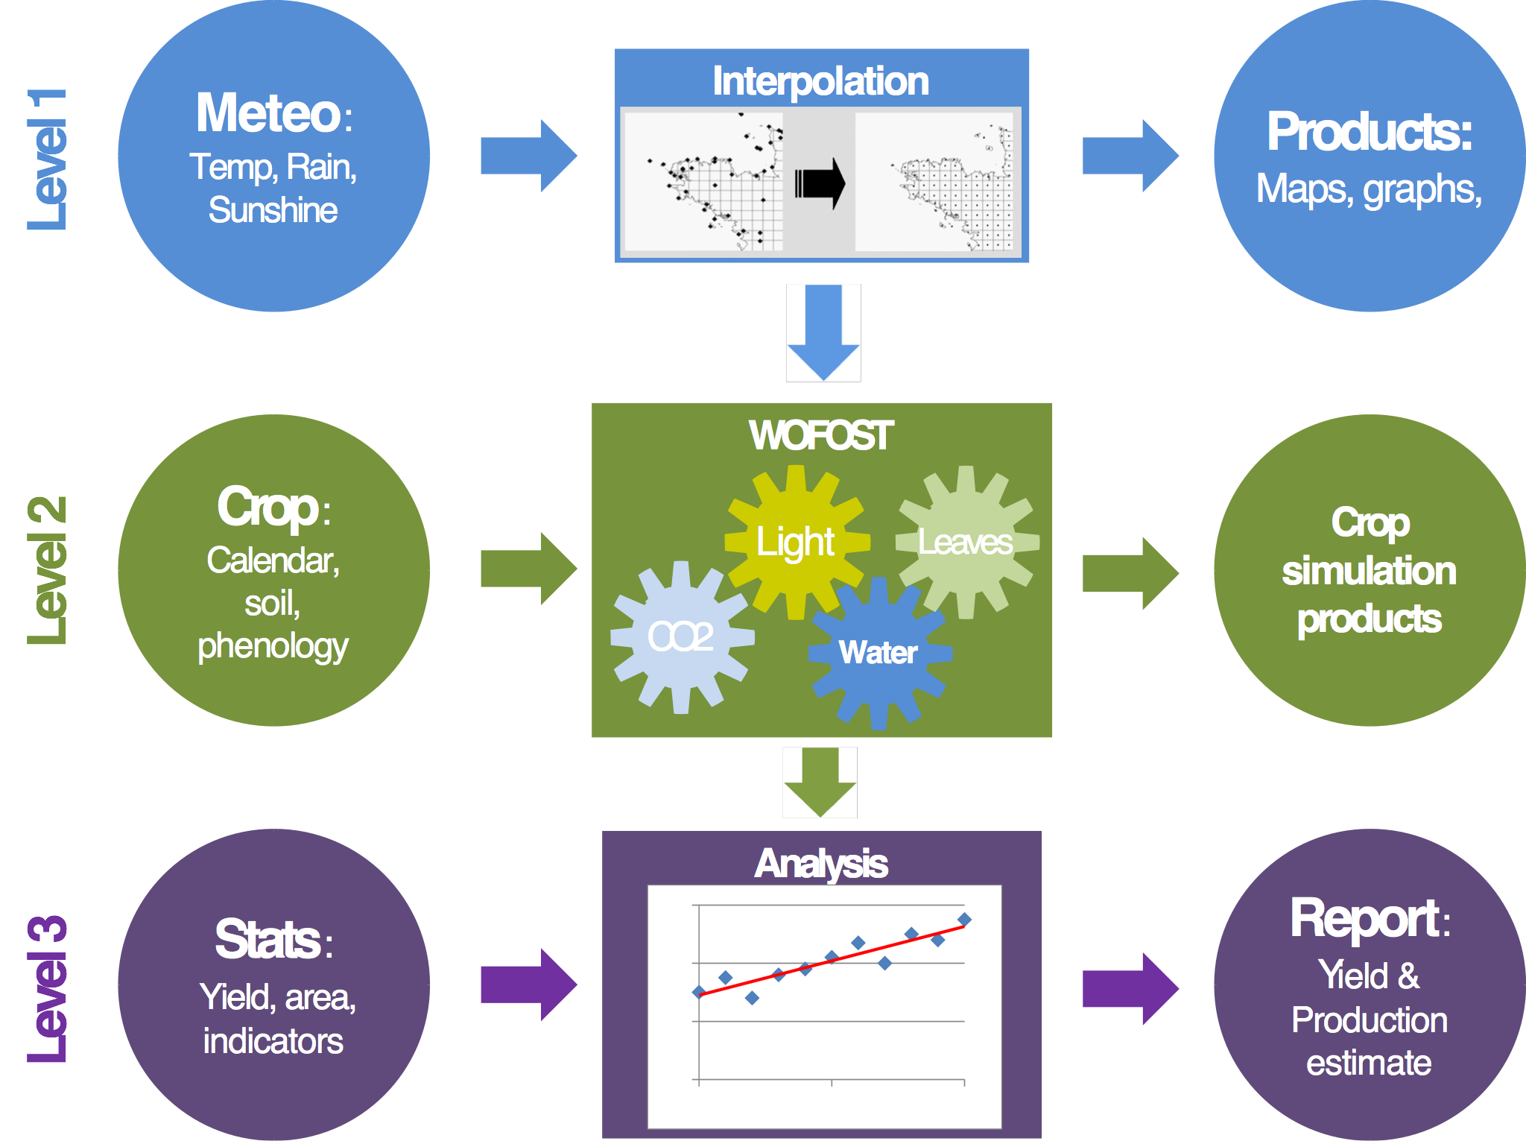
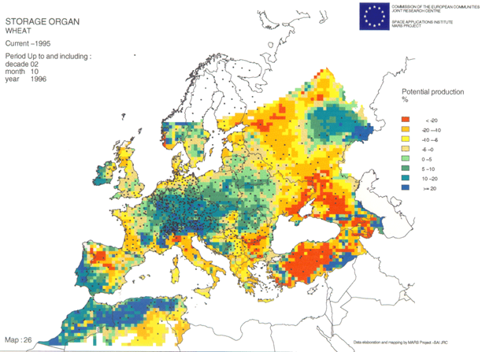
WOFOST applications: MARS
Notes:
MARS
WOFOST is run for all major arable crop in Europe at fine grid with local weather, soil and crop data
Including an archive and up to today
Used to follow the growing conditions and production in the on-going season to detect anomaly hotspots
Input for statistical framework of crop yield forecasting at national level

Slide 37
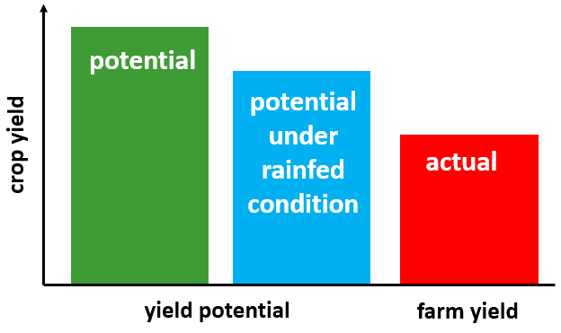

WOFOST applications: GYGA
GYGA explores possibilities for extra production and intensification under full irrigation & rainfed conditions for crops across the globe
GYGA is an international initiative with:
National agronomists with local knowledge
Standard protocol for assessing yield potential (Yp), water-limited yield potential (Yw) and yield gaps (Yg)
Based on best available local data
Robust crop simulation models (WOFOST, CERES-MAIZE embedded in DSSAT 4.0 etc.)
Bottom-up approach to upscale results from location to region and country
www.yieldgap.org
Notes:
GYGA
Used to make investments in agricultural R&D, studying intensification pathways, strategies on input requirements etc.

Slide 38
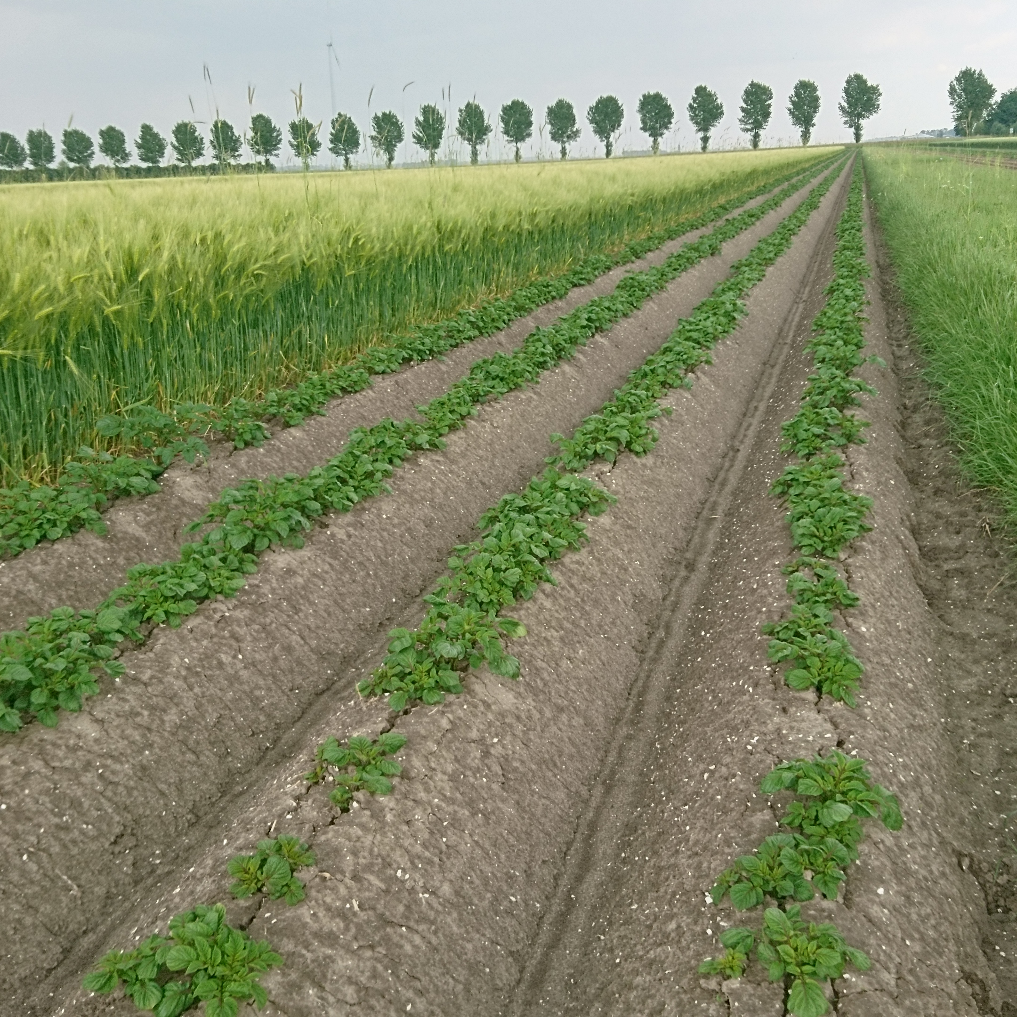
Thank you for your attention
Any questions?

